Slide 1


TOKYO OLYMPICS 2020
ANALYSIS
28 DECEMBER 2021 | BRYAN TAMIN

Slide 2



What is the scoring factor
for the rank
and rank by total?
Problem
Statement
What is the correlation between
income of a country and
its rank in Tokyo Olympic 2020?
How the population of a country
affects their rank in
Tokyo Olympics 2020?

Slide 3
EXECUTIVE SUMMARY
Rank is based on the highest gold medal first, then the highest silver medal, then the highest bronze medal counts
Rank by total is based on the highest total medal
Countries with high income tend to rank high in Tokyo Olympics 2020 (high impact)
Countries with high population tend to rank high in Tokyo Olympics 2020 (slight impact)

Slide 4




What is the scoring
factor for the rank
and rank by total?

Slide 5
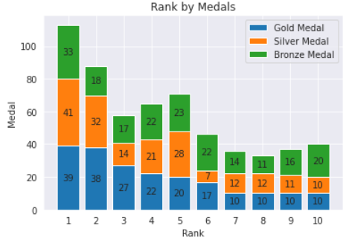
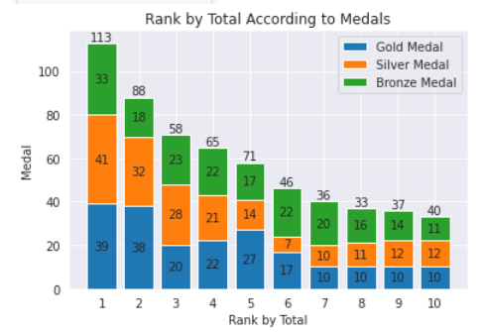
Rank is sorted by gold medal counts first, then silver medal counts, and then bronze medal counts
Rank by total is sorted by the highest total medal counts

Slide 6
What is the correlation between
income of a country and
its rank in Tokyo Olympic 2020?

Slide 7
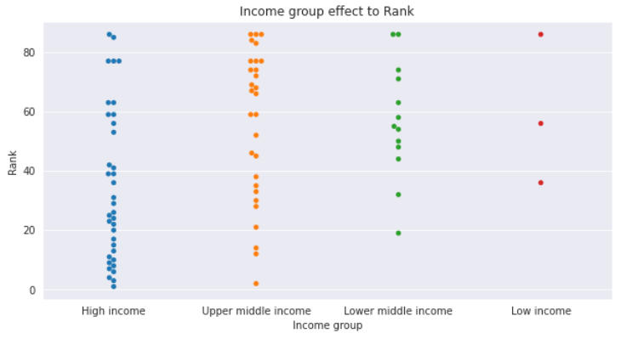
Countries with high-income group tend to have a higher rank compared to the one with lower income group
The top 50% of the rank is populated by more than 50% high-income group, on the other hand, the bottom 50% of the rank is mostly populated by upper-middle (almost 50%) and lower middle (almost 25%) income group countries

Slide 8
How the population of a country
affects their rank in
Tokyo Olympics 2020?

Slide 9
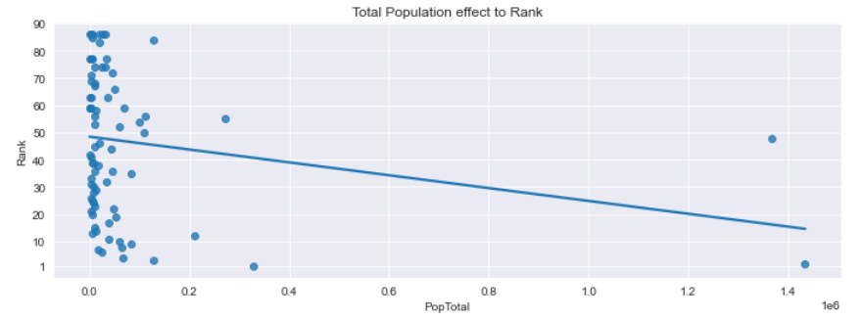
The regression line shows that countries with a high population tend to have a high rank in Tokyo olympics 2020

Slide 10




Thank you

